Slide 1
Capstone Engagement
Assessment, Analysis, and Hardening of a Vulnerable System

Slide 2
Table of Contents
This document contains the following sections:
01
Network Topology
02
Red Team: Security Assessment
03
Blue Team: Log Analysis and Attack Characterization
Hardening: Proposed Alarms and Mitigation Strategies
04

Slide 3
Network Topology
‹#›

Slide 4
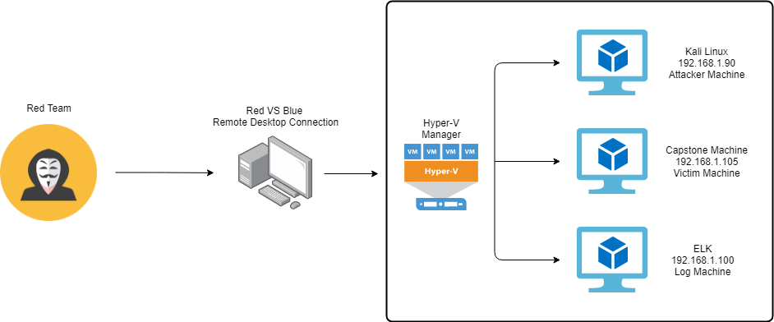
Network Topology
Network
Address Range: 192.168.1.0/24
Netmask: 255.255.255.0
Gateway: 192.168.1.1
Machines
IPv4: 192.168.1.90
OS: Kali Linux
Hostname: Kali
IPv4: 192.168.1.105
OS: Linux
Hostname: Server 1/Capstone
IPv4: 192.168.1.100
OS: Linux
Hostname: ELK
IPv4: 192.168.1.1
OS: Windows 10
Hostname: Gateway

Slide 5

Red Team
Security Assessment
‹#›

Slide 6
Recon: Describing the Target
Nmap identified the following hosts on the network:
Hostname | IP Address | Role on Network
Hyper-V Manager | 192.168.1.1 | Gateway for the VMs
Kali Linux | 192.168.1.90 | Pentester
Capstone | 192.168.1.105 | Victime Machine with the vulnerable Apache Web Server
ELK | 192.168.1.100 | SIEM system with Kibana allowing monitoring of the Network security.

Slide 7
Vulnerability Assessment
The assessment uncovered the following critical vulnerabilities in the target:
Vulnerability | Description | Impact
CWE-548: Exposure of Information Through Directory Listing | CWE-548 refers to having a directory listing exposed and unprotected. | This allows the attacker to simply look through the directory contents through a web server to find sensitive information.
CWE-521: Weak Password Requirements | CWE-521 refers to having a simple and weak password when it is recommended to having long and stronger passwords with different characters. | This vulnerability makes it easier for an attacker to crack a password and gain access to confidential information.
CWE-307: Improper Restriction of Excessive Authentication Attempts | CWE-307 refers to when softwares do not limit the amount of failed logins with a certain time frame. | This in combination with CWE-521 described above makes it incredibly easy for hackers to brute force attack your login information.
CWE-311: Missing Encryption of Sensitive Data | When a software does not encrypt sensitive/confidential information before it is uploaded. | CWE-311 makes confidential information exposed and accessible.

Slide 8
Vulnerability Assessment
The assessment uncovered the following critical vulnerabilities in the target:
Vulnerability | Description | Impact
CWE-434: Unrestricted Upload of File with Dangerous Type | Allows the upload of dangerous files onto a server. | This allows attackers to install scripts on servers that will automatically get processed and give full access to the attacker.

Slide 9
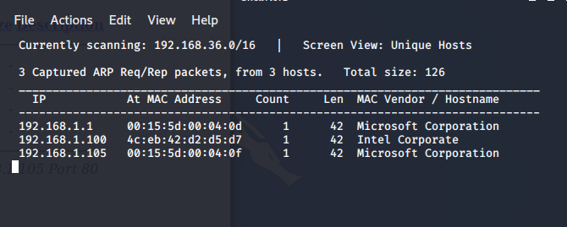
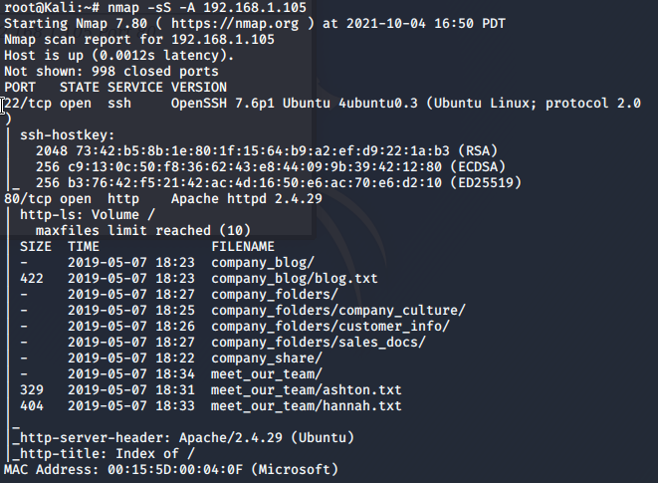
Exploitation: CWE-548: Exposure of Information Through Directory Listing
01
02
03
Tools & Processes
Netdiscover: Scans all live hosts on a network
Nmap: Scanned IP Address 192.168.1.105 to see which ports are open.
Achievements
Found 3 hosts and after using a Web browser to test we found 192.168.1.105 was host we are looking for.
Scanning IP address 192.168.1.105 allowed us to locate the list of directories.

Slide 10
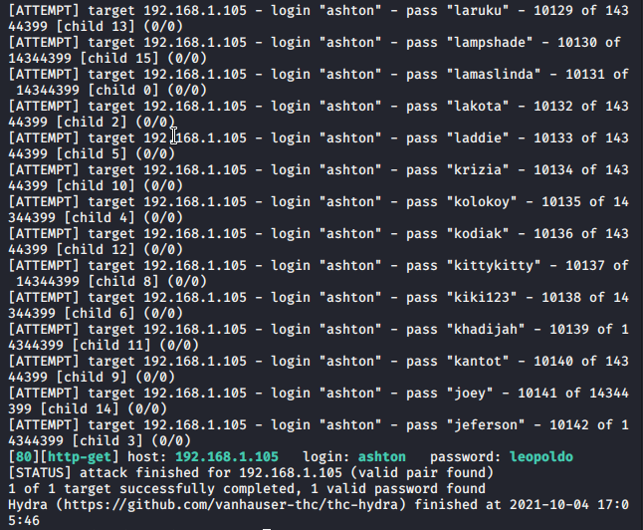
Exploitation: CWE-521: Weak Password Requirements
01
02
03
Tools & Processes
Hydra: Ran a list of passwords for user Ashton in connection to the secret folder we found previously
Command: hydra -l ashton -P /opt/rockyou.txt -s 80 -f -vV 192.168.1.105 http-get "/company_folders/secret_folder"
Achievements
Hydra cracked Ashton’s password being leopoldo.
Obtaining this password allowed to access sensitive information on how to connect to webdav with the login of user Ryan.

Slide 11
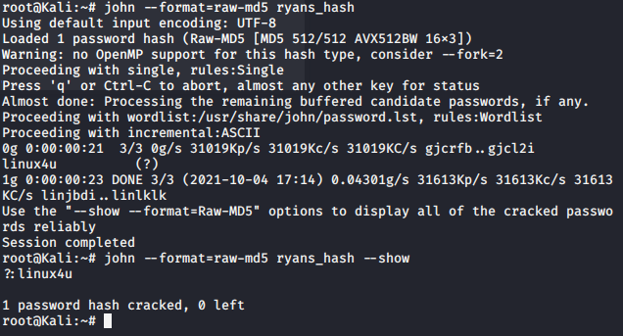
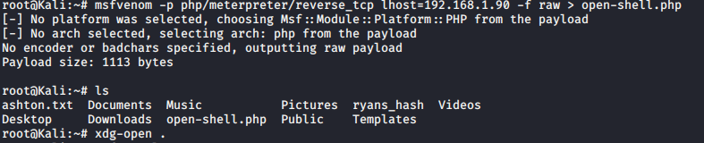
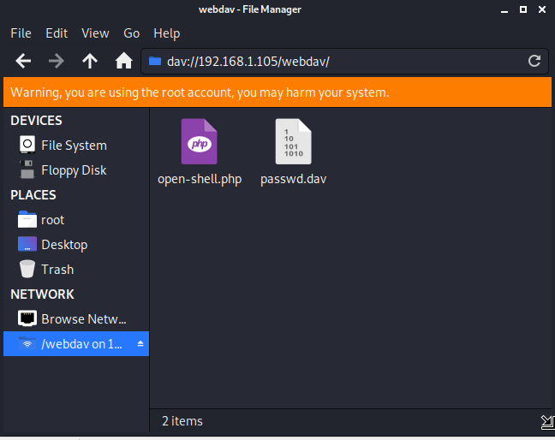
Exploitation: CWE-434: Unrestricted Upload of File with Dangerous Type
01
02
03
Tools & Processes
John the Ripper: Used to crack hashed passwords.
Msfvenom: Creates a reverse PHP reverse TCP shell script called shell.php
Achievements
Cracked Ryan MD5 hash password and give us access to webdav.
Allowed us to upload the script onto the server and create a meterpreter session.

Slide 12

Blue Team
Log Analysis and Attack Characterization
‹#›

Slide 13
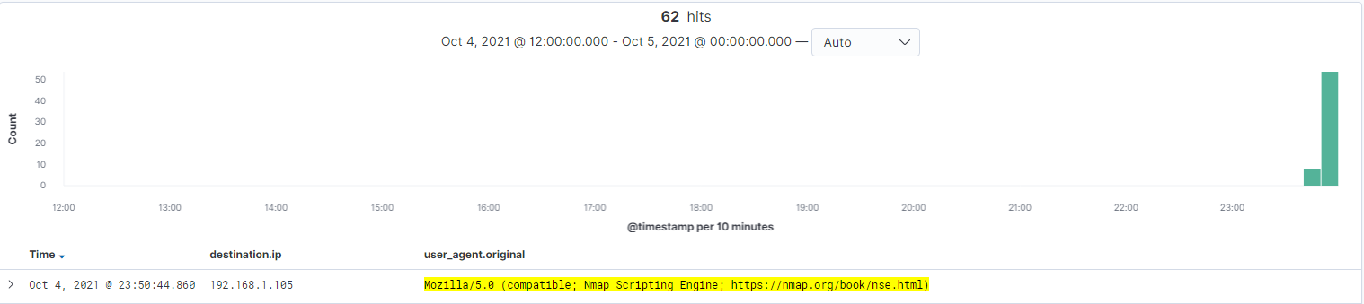
Analysis: Identifying the Port Scan
What time did the port scan occur? The port scan occurred between 11:40 pm and 11:50 pm.
How many packets were sent, and from which IP? 62 packets were sent from 192.168.1.90.
What indicates that this was a port scan?It is indicated this was a port scan by the User Agent being an Nmap Scripting Engine.

Slide 14
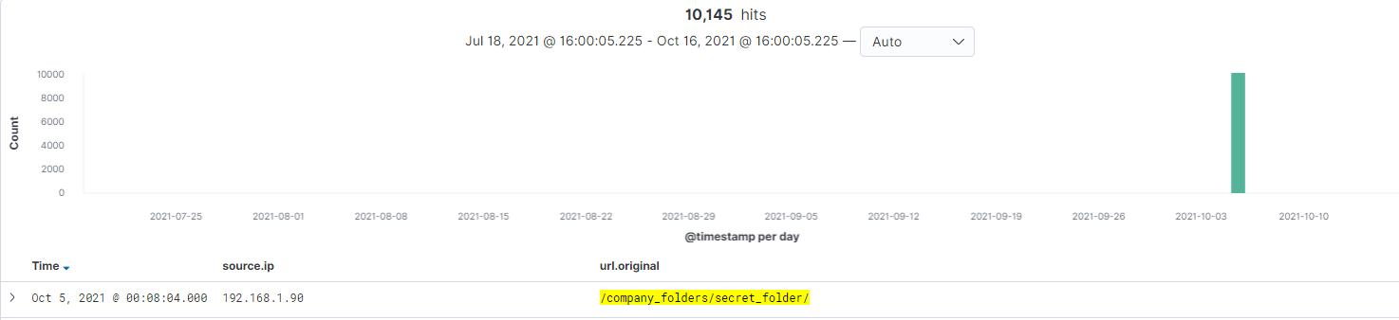
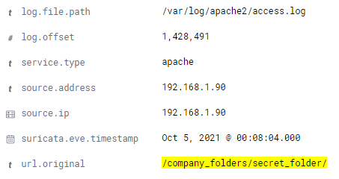
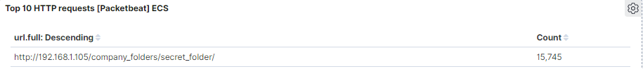
Analysis: Finding the Request for the Hidden Directory
[Insert Here]
What time did the request occur? How many requests were made? The request occurred at 08:00 am. 10,145 requests were made.
Which files were requested? What did they contain? The file requested was access.log which contained information of how to access WebDAV.

Slide 15
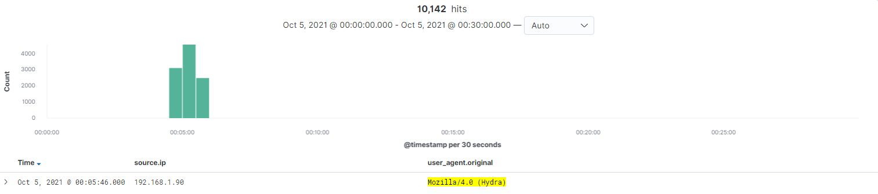
Analysis: Uncovering the Brute Force Attack
[Insert Here]
Include a screenshot of Kibana logs depicting the brute force attack.
How many requests were made in the attack? 10,142 requests were made in the attack.
How many requests had been made before the attacker discovered the password? 10,141 requests were made before the password was discovered.

Slide 16
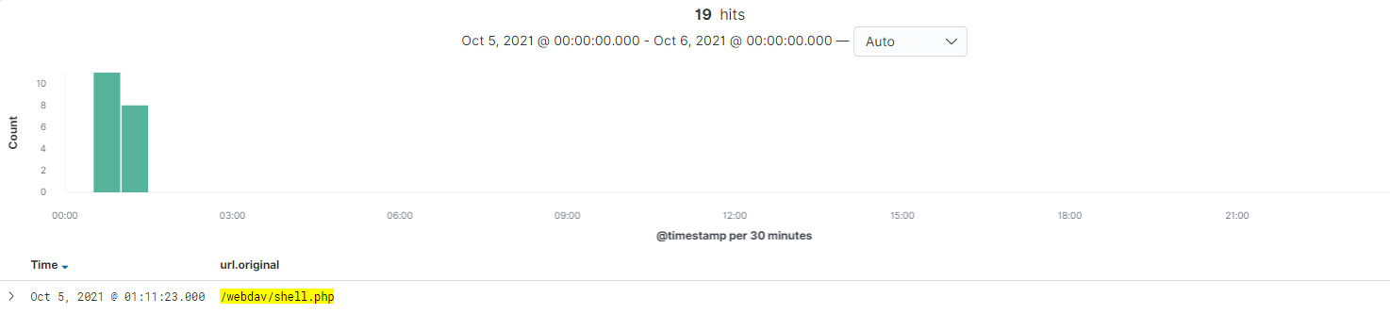
Analysis: Finding the WebDAV Connection
How many requests were made to this directory? 19 requests were made to this directory
Which files were requested? The requested files were shell.php and passwd.dav that were in the webDAV directory.

Slide 17
Blue Team
Proposed Alarms and Mitigation Strategies
‹#›

Slide 18
Mitigation: Blocking the Port Scan
What kind of alarm can be set to detect future port scans?
Set alarms for use of Nmap.
What threshold would you set to activate this alarm?
Any use of Nmap should activate the alarm.
What configurations can be set on the host to mitigate port scans?
Create a whitelist of users allowed to scan or Nmap the network and block any other unauthorized and unknown users.
Close ports that are not being used to avoid leaving openings for attackers.

Slide 19
Mitigation: Finding the Request for the Hidden Directory
What kind of alarm can be set to detect future unauthorized access?
An alarm should be set to detect unknown connections to the directory .
If there’s bigger traffic than usual to the directory.
What threshold would you set to activate this alarm?
Any unknown IP that attempts to access the folder should activate this alarm.
What configuration can be set on the host to block unwanted access?
Rename the Hidden Folder directory so it is less obvious of the importance of the information within it.
Whitelist certains users to access the Hidden Folder.
Encrypt the folder.
Add password protection to the directory itself even if you’re whitelisted.

Slide 20
Mitigation: Preventing Brute Force Attacks
What kind of alarm can be set to detect future brute force attacks?
Set an alarm if there’s is too many failed attempts at entering a password.
What threshold would you set to activate this alarm?
If there’s is more than 3 failed attempts for any login page or password protected folder.
What configuration can be set on the host to block brute force attacks?
If a User fails too many times at entering a correct password, they will be blocked until their account is unblocked by a supervisor or an IT department.
And in case an attacker manages to access a password protected folder or account in 3 tries or less, some Multi-factor Authentication will prevent any further intrusion.

Slide 21
Mitigation: Detecting the WebDAV Connection
What kind of alarm can be set to detect future access to this directory?
Alert for unauthorized user connecting to WebDAV(non-whitelisted).
What threshold would you set to activate this alarm?
Any attempted connection from unauthorized users.
What configuration can be set on the host to control access?
Only previously authorized IP addresses are allowed to access the website. Restricting only certain machines and users allows the software to control connections from attackers through the web and regulates any abnormal connections.

Slide 22
Mitigation: Identifying Reverse Shell Uploads
What kind of alarm can be set to detect future file uploads?
Create an alarm for when a file is created, edited or uploaded to the server.
Create a high-level alert for .php files being uploaded or created.
Block any unknown connections to HTTP ports.
What configuration can be set on the host to block file uploads?
Install an antivirus software that scans all uploaded files.
Block any uploading of files with .php extensions or any other possibly dangerous extensions.

